Slide 1
Talend Overview

Slide 2
Talend Features
CLIENTS
SERVER
TAC
Talend Administrative Control (TAC) Enables the management and administration of all projects.
Administration metadata (user accounts, access rights and project authorization for example) is stored in the Administration database.
Data of project items (Jobs, Business Models and Routines for example) is stored in the SVN or Git server.
The Client block Includes one or more Talend Studio(s) and Web browsers that could be on the same or on different machines.
The Server block includes a web-based application server and Talend Administration Center(TAC)

Slide 3
Talend Architecture
CLIENTS
SERVER
TAC
Talend Administrative Control (TAC) Enables the management and administration of all projects.
Administration metadata (user accounts, access rights and project authorization for example) is stored in the Administration database.
Data of project items (Jobs, Business Models and Routines for example) is stored in the SVN or Git server.
The Client block Includes one or more Talend Studio(s) and Web browsers that could be on the same or on different machines.
The Server block includes a web-based application server and Talend Administration Center(TAC)

Slide 4
Repositories
Talend Execution Servers
Databases
Talend Administrative Control (TAC) Enables the management and administration of all projects.
Administration metadata (user accounts, access rights and project authorization for example) is stored in the Administration database.
Data of project items (Jobs, Business Models and Routines for example) is stored in the SVN or Git server.
The Repositories block includes the SVN or Git server and the Nexus repository.
The Talend Execution Servers block includes one or more execution servers, deployed inside your information system.
The SVN or Git server is used to centralize all project items
Talend Jobs are deployed to the Job servers through TAC

Slide 5
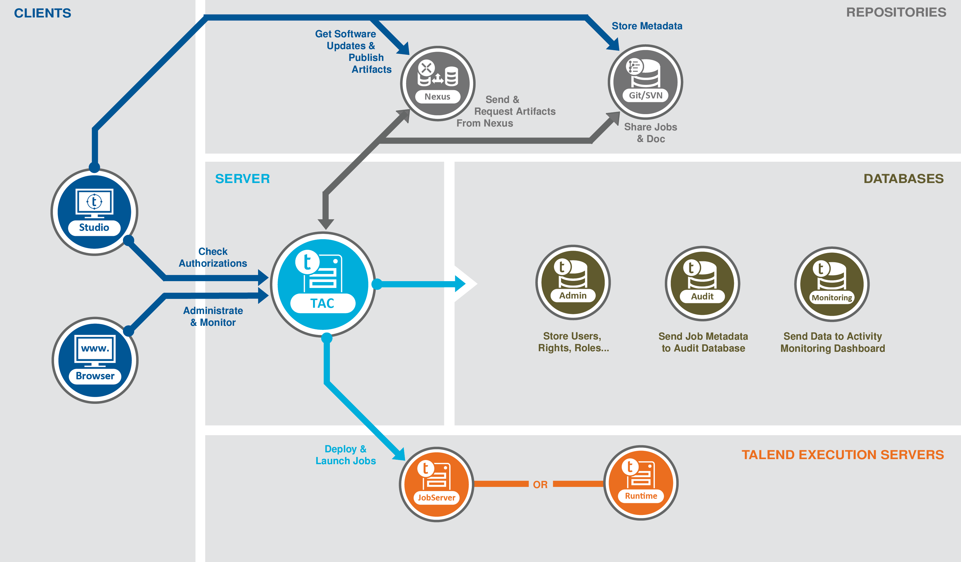

Slide 6
Cost Comparison
Point out financial benefits to the customer.
Compare costs of your product or service with one or more competitors.
Custom Research Service | Trey Research Cost* | Company A Cost*
Market entry analysis | X | X
Industry benchmarking | X | X
Pricing and brand analysis | X | X
Forecasting and planning | X | X
Subscription Research Service | X | X
Consumer industry market reports | X | X
Online global business intelligence database | X | X
* Cost of custom research service depends on project scope

Slide 7
Our Strengths
Durable goods
Electronics
Healthcare
Foods
Consumer Goods and Services
Global Data
Research Network
Benchmarking
Brand intelligence
Trends
Industry and Technology Markets
Finance
B2B Services
Machinery
Media
Trade

Slide 8
Key Benefits of Product or Service
Summarize the key benefits provided by the product or service you are promoting.
Example:
Investment in market research is an investment in your product’s success!
Know your customer
Know your competition
Timing is everything
Track and adjust

Slide 9
Next Steps
Outline the next steps for ordering or purchasing your products or services.
Example:
To commission research from Trey Research:
Define the project
First, we’ll meet with you to define your project.
Submit a research proposal
Then, we’ll submit a proposal for your evaluation.
Begin the research
When the proposal is approved, we will assemble an experienced team to conduct your research and analyze the findings.
Provide ongoing support
We will continue to work with you after we deliver your report so you get the most value out of the research findings.

Slide 10
Contact Information
Provide contact information for key personnel from your company.
Provide e-mail and Web site information, if appropriate.

